Slide 1



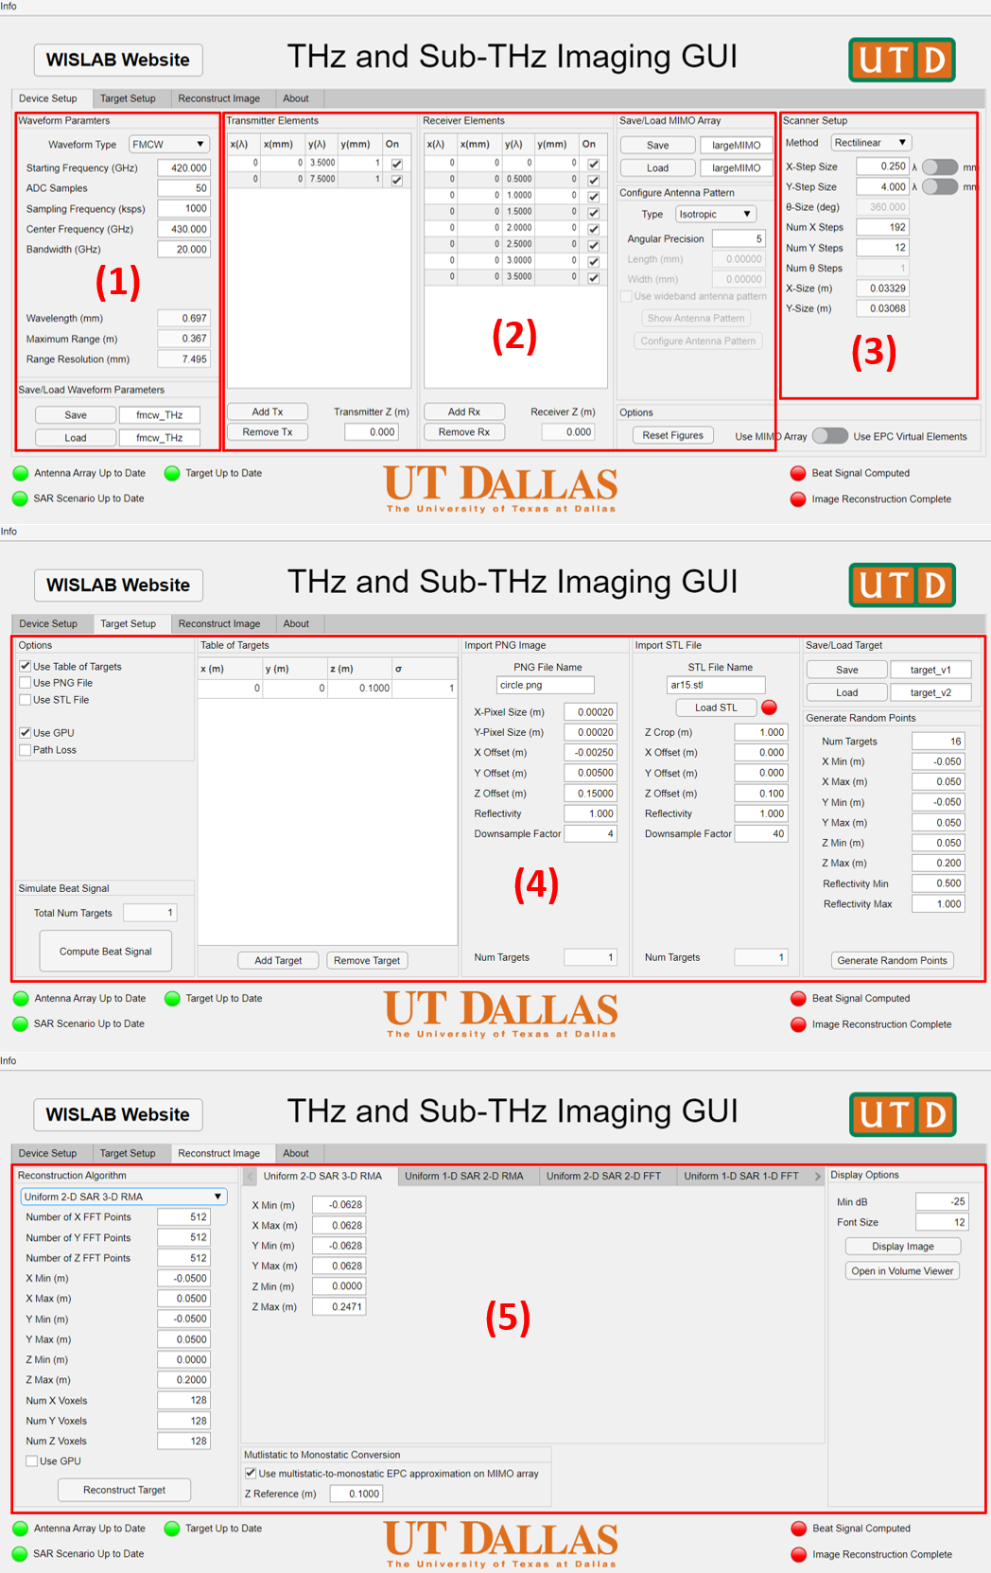
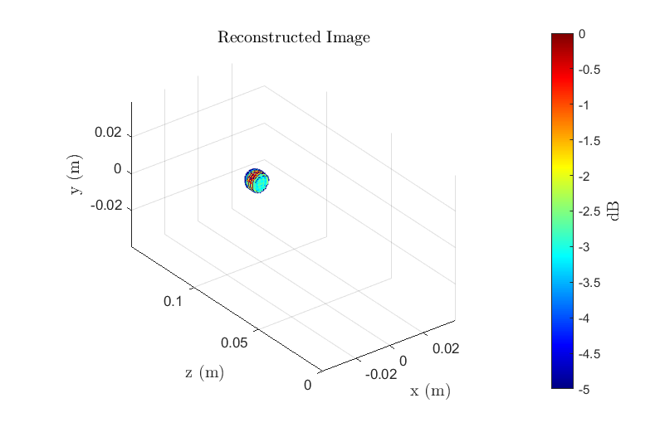
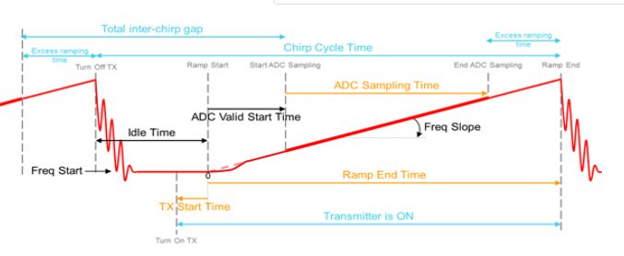
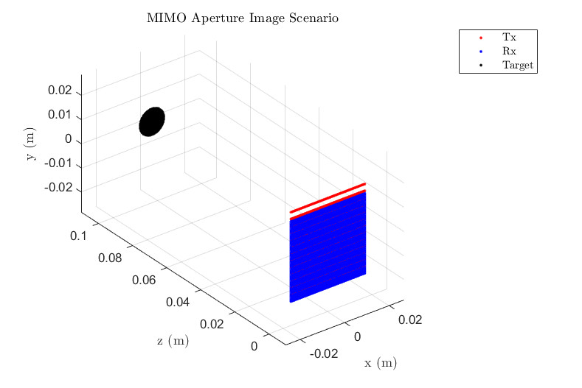
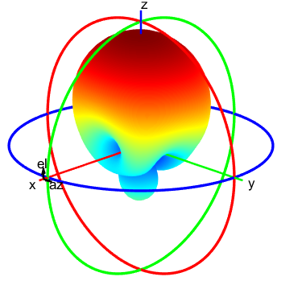
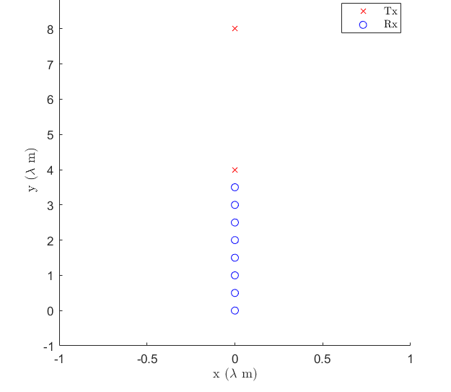
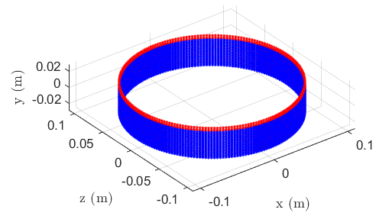
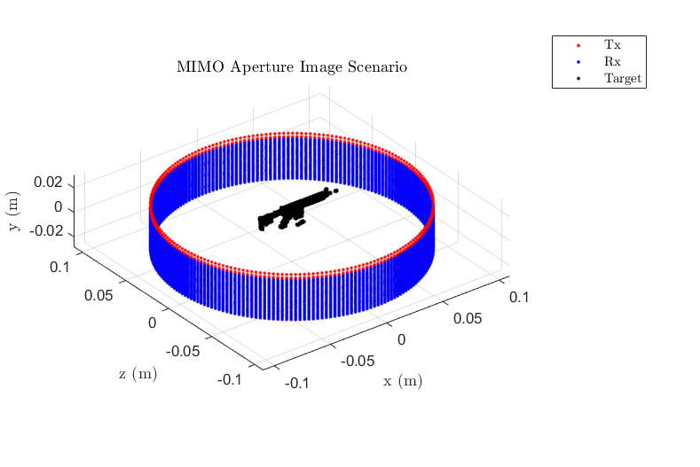
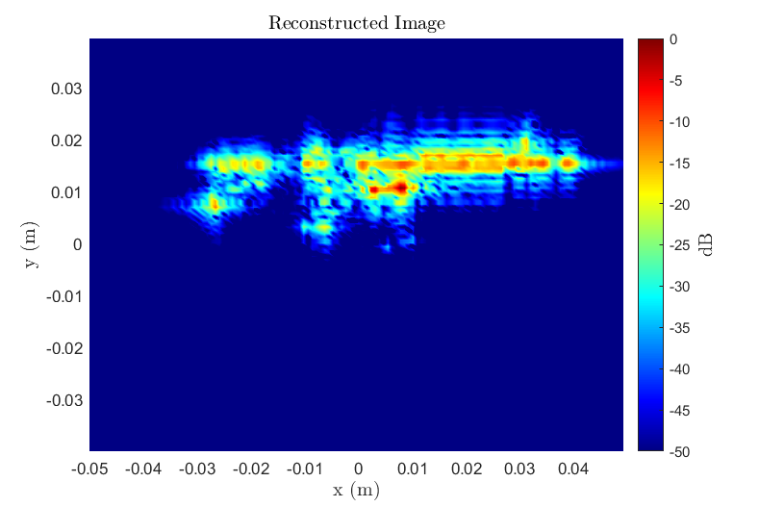
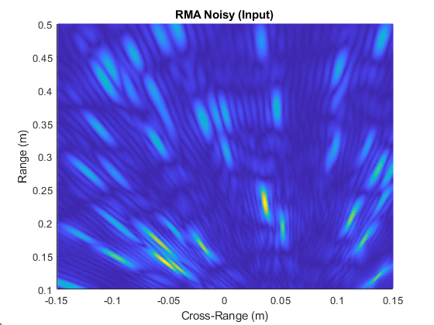
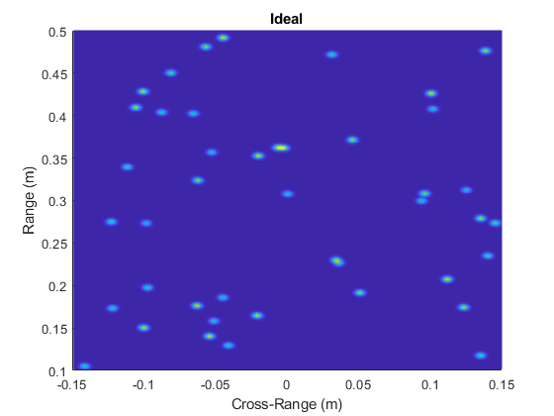
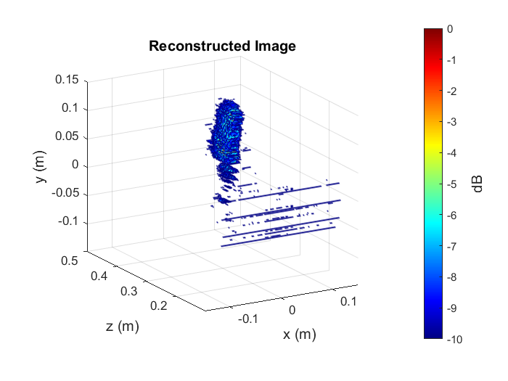
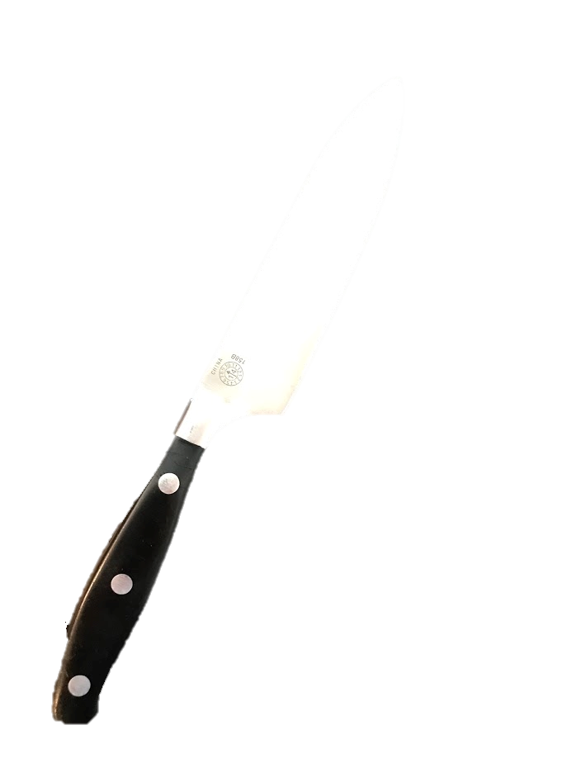
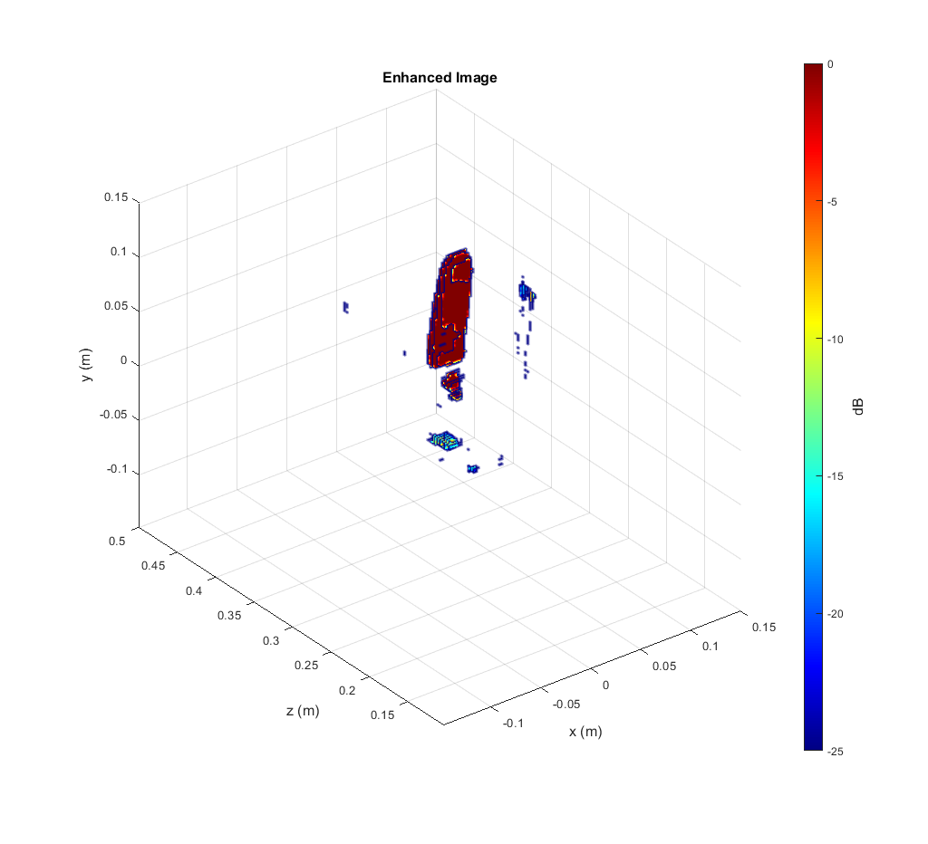

Terahertz Imaging Toolbox with Interactive User Interface
Josiah W. Smith¹, Murat Torlak¹
¹The University of Texas at Dallas, 800 W Campbell Rd Richardson, TX 75080
Motivation
2. MATLAB Interface
As terahertz systems become increasingly viable, there is a need for efficient system prototyping, algorithm development, and ML dataset generation
Full control over transmitted waveform
Create antenna gain pattern and MIMO array
Set scanning scenario
Create target scene to image
Point reflectors at specified locations
Import 2-D images
Import 3-D STL files
Generate randomly placed points (dataset generation)
Reconstruct the image
Use built-in algorithms
Develop, test custom imaging algorithms
Rapidly prototype THz imaging systems
1. Background
Previous work on THz simulation platforms has been limited to far-field simulation or computationally-expensive antenna simulation.
We present a new MATLAB-based approach to THz imaging simulation enabling rapid THz system prototyping, imaging algorithm development, and machine learning model training.
(1) - Waveform
3. THz Simulation Steps
(2) - Antenna
(3) - SAR Scan
(4) - Target
(5) - Image
4. Machine Learning Dataset Generation
5. Summary
Training neural processors requires access to large, meaningful datasets
Supervised learning → features and corresponding labels
Solution: our simulation platform can efficiently generate large datasets for ML training
Our simulation interface enables:
Rapid prototyping of THz imaging systems
Simplified imaging algorithm development
Machine learning applications built on THz imaging by efficient dataset generation of high-fidelity data
Neural Processor (CNN-based)
Future Work
Extend simulation platform capabilities
Target material properties
Varying propagation media (through-the-wall)
Multipath effects
Develop neural processors for improved imaging
Hybrid signal processing + ML
Exceeds theoretical spatial/spectral resolution
Features: distorted reconstructed images
Real 77GHz Results
Labels: ideal input reflectivity intensity maps
Input
Output
Publication
[1] J. W. Smith and M. Torlak, “Terahertz Imaging Toolbox with Interactive User Interface,” Submitted in IEEE Open Journal on Antennas and Propagation
Acknowledgments
Reduced noise floor ~15dB
This work is supported by Texas Instruments through Foundational Technology Research Centre (FTRC).

